Slide 1
Expedia Hotel price prediction
Weekly Update 12
Team Dragonflies

Slide 2
Content
Feature structure
Pipeline structure
Sub-feature analysis (time)

Slide 3
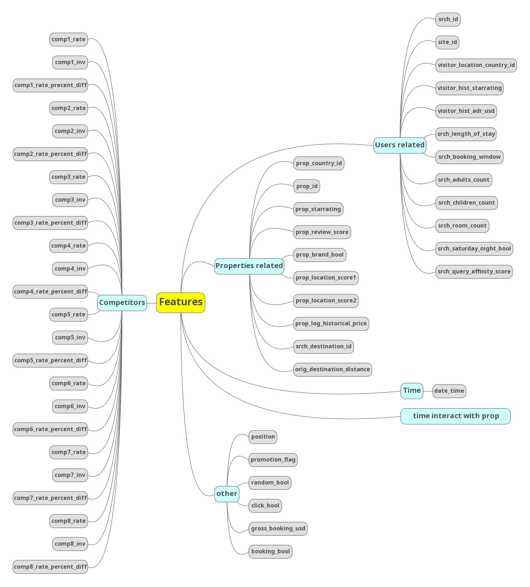
Feature Engineering
Feature structure

Slide 4
Pipeline structure
Pipeline structure
Users
Modeling 1
stacking
clustering
Properties
Modeling 2
Time
Modeling 3
Time interact with Properties
Modeling 4
Competitors
Modeling 5
Other
Modeling 6

Slide 5
Pipeline structure
Pipeline structure
Users
Modeling 1
stacking
Iterating
Properties
Modeling 2
Time
Modeling 3
Time interact with Properties
Modeling 4
Competitors
Modeling 5
Other
Modeling 6

Slide 6
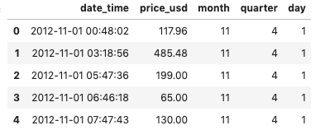
Time features
analysis
Try aggregating data by day, by month, by quarter, etc.
(by averaging prices)
Questions to answer:
How much variation shown in different day, month, quarter ?
How to combine these time features into modeling? (Current challenge)
*sampled 10000 records from dataset

Slide 7
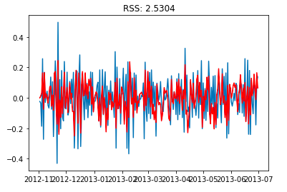
Time features
analysis
2. Moving Average: aggregate price data by day (averaging price)
Log-transform price
*sampled 10000 records from dataset

Slide 8
Time features
analysis
Next:
Trying to aggregate price by property + by day

